Slide 1
READ ME This template uses the font ‘Space Grotesk’ – be sure to download the font before making edits to the deck. Here’s the link to the ZIP file containing the font. If you cannot access the link above, you can download the font for free via Google Fonts.

Slide 2
Deployment to Azure Container Apps

Slide 3
Azure Container Apps

Slide 4
Serverless Kubernetes Cluster

Slide 5
Deploying apps via Azure Developer CLI

Slide 6
azd init
azd up
azd deploy

Slide 7
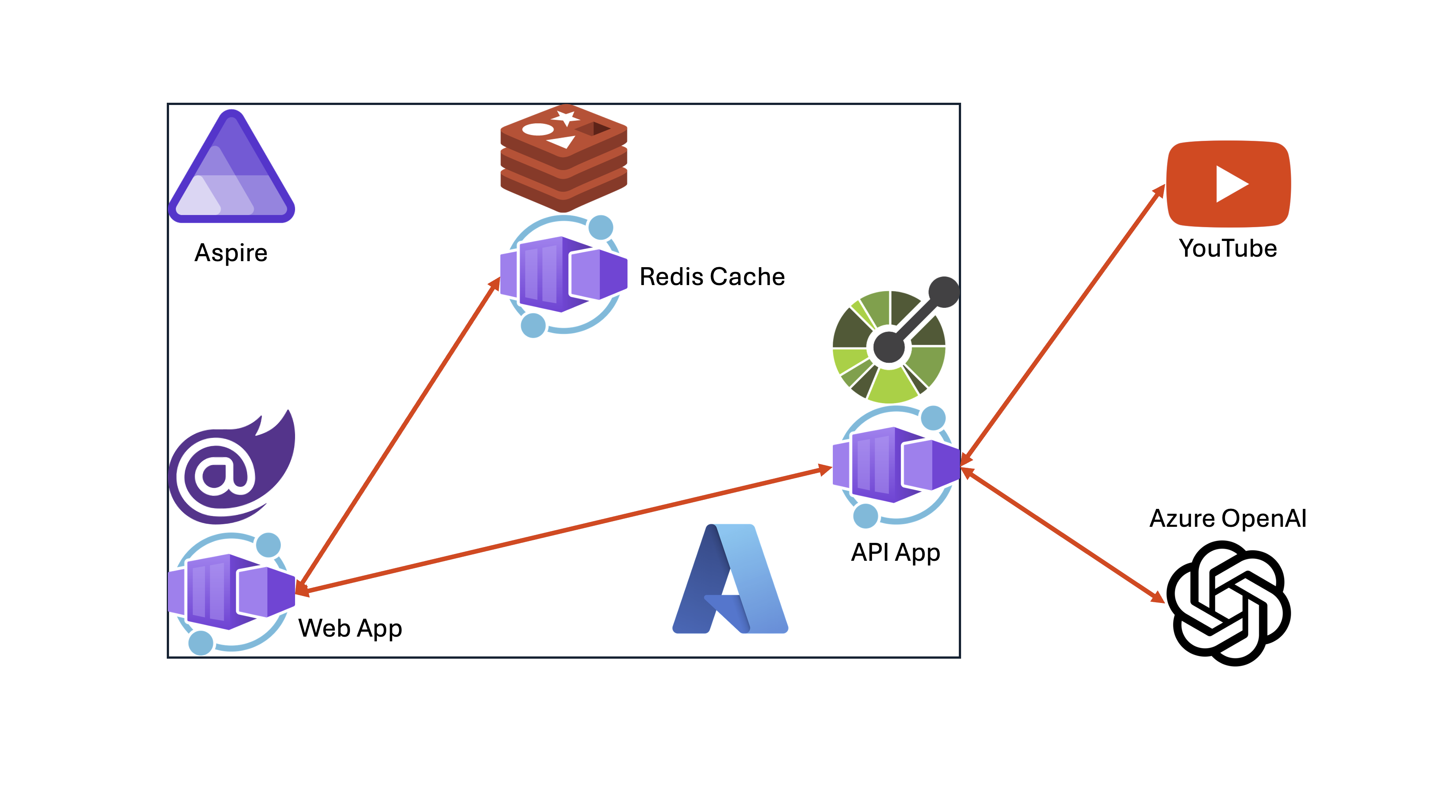

Slide 8
Let’s get started!
https://aka.ms/aspireinadaykr

